Slide 1
Understanding Algorithms
Digital Technology SUCCESS CRITERIA: I CAN design algorithms that use a range of data types, branching and iteration and represent them diagrammatically and in English

Slide 2
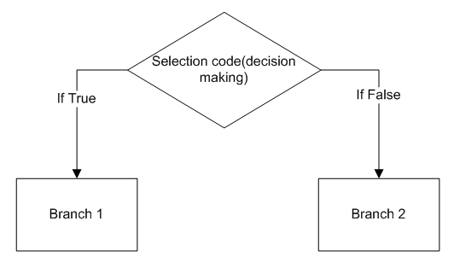
UNDERSTANDING THE SUCCESS CRITERIA
Branching: When an "Algorithm" makes a choice to do one of two (or more things) this is called branching.
Example: If I was writing a code to separate boys from girls for a in class, I would say IF you are a girl move to the left, ELSE, move to the right.

Slide 3
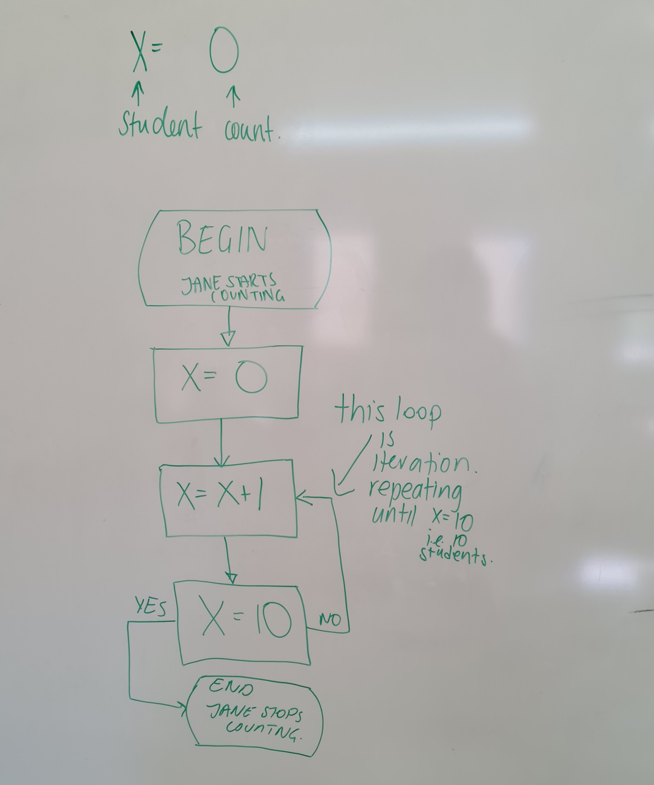
Iteration: a sequence of instructions or code being repeated until a specific end result is achieved
For example, Jane wanted to count 10 students from her year 8 homeroom, so she has 10 students assisting in the upcoming talent show. How would you represent this in an algorithm

Slide 4
Data:
- It is a collection of facts (words)and figures (numbers) to be used for a specific purpose such as a survey or analysis. When arranged in an organized form, can be called information.

Slide 5

So let’s look out what Algorithms are

Slide 6
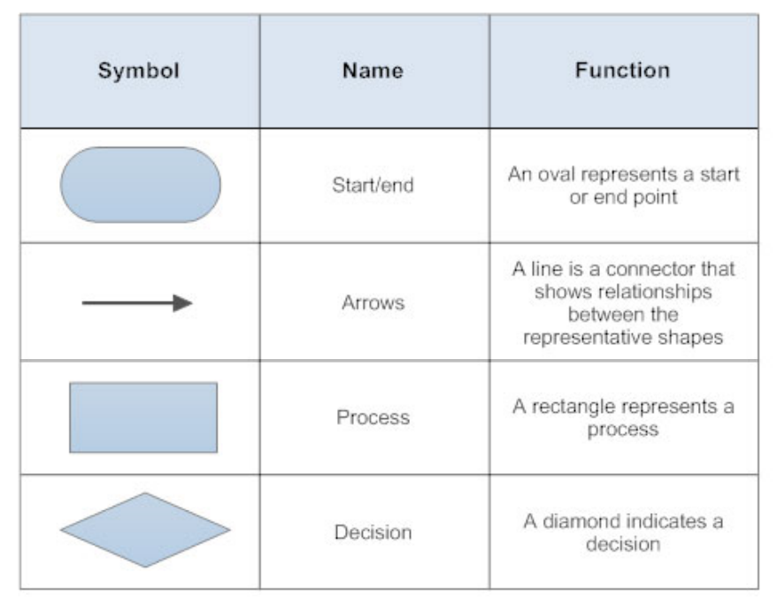
Symbols used in algorithms

Slide 7
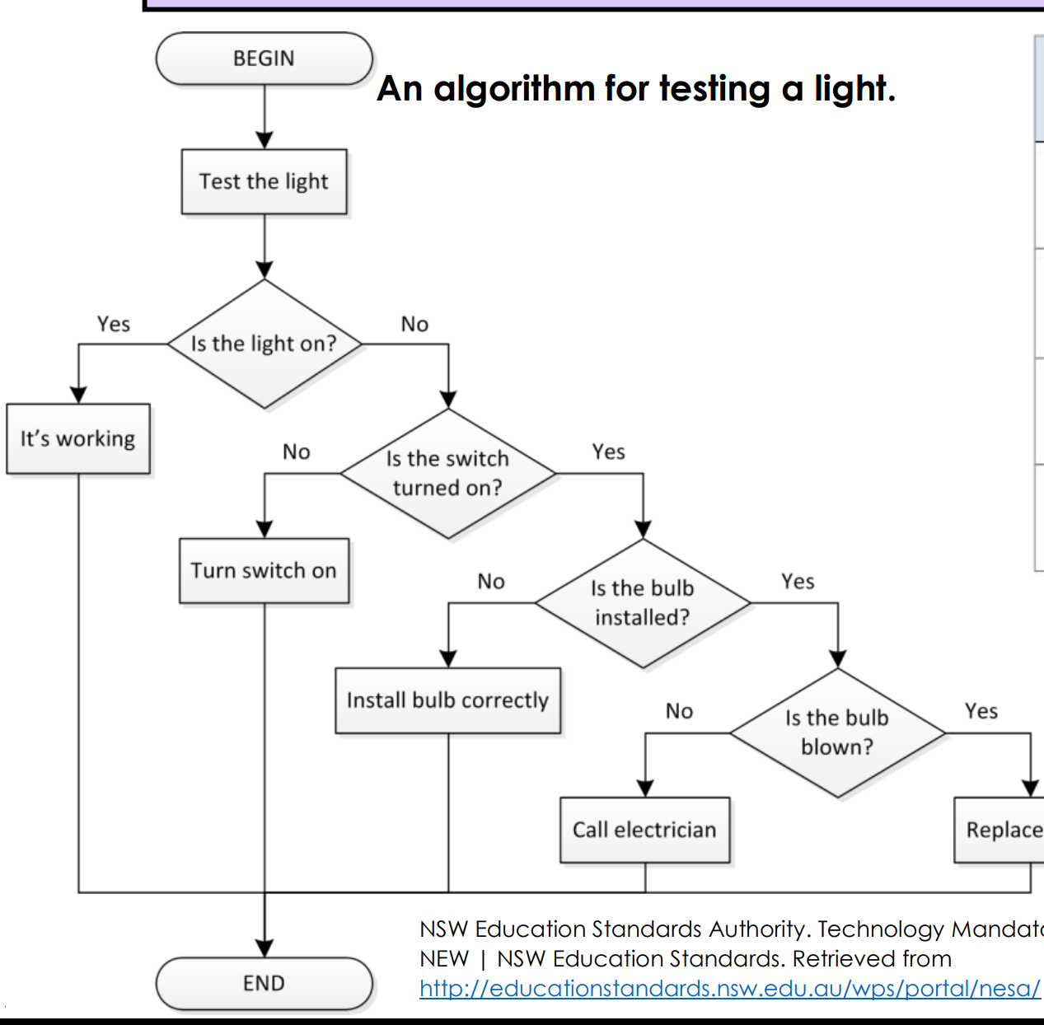
Example 1: Testing a light

Slide 8
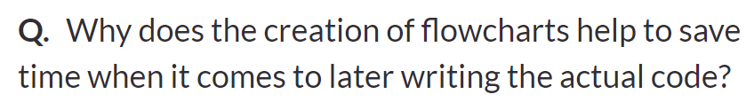
Recap questions

Slide 9
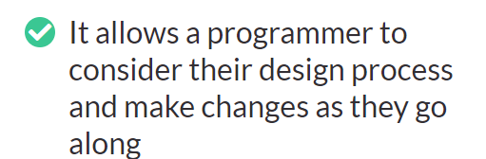

Slide 10
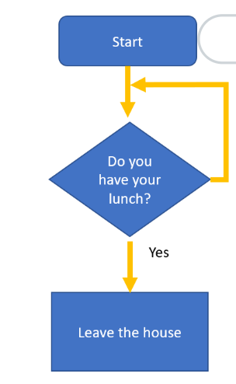
What does this flowchart represent?

Slide 11
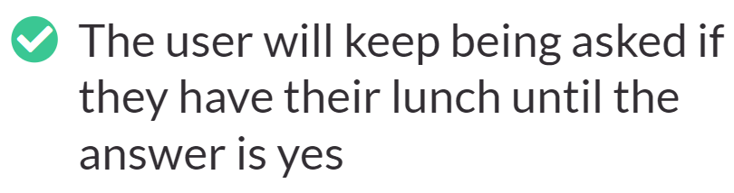

Slide 12
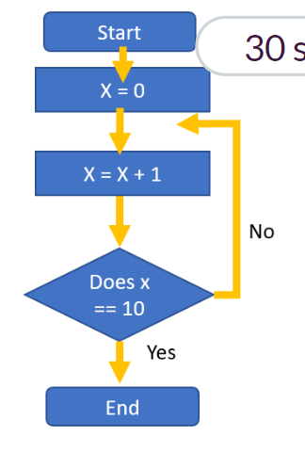
What does this flowchart represent?

Slide 13
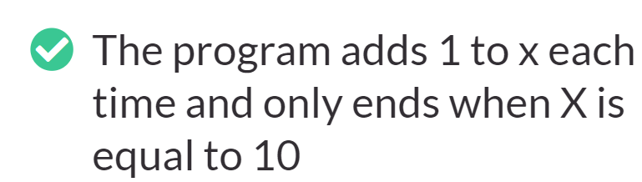

Slide 14
Your assessment (Part A – Question 2)
Log into GROK, go to the TAB FULL SMART GARDEN
You now need to covert that code into a flow chart. Remember it needs to have a START and END.
Options to represent button a and b
Remember to use the right shapes- check teams for some examples.

